Slide 1
Vietnamese Spelling Correction using Transformer with Tokenization Repair
Group 2

Slide 2
Team members
Nguyễn Đình Duy 20190096
Cao Tiến Trung 20190098
Trần Thế Thịnh 20194853
Bùi Thị Phương Anh 20150022
Vũ Thanh Hải 20194756

Slide 3
Outline
Introduction
Modeling
Dataset
Training, Evaluation Details
Experimental Results
Demo

Slide 4


Introduction
The need of Spelling Corrector: Search Engine
Public search engine query logs show that large amounts of queries entered in are misspelling (10 – 12%)
Which require further processing in order to enhance user’s experience

Slide 5

Introduction
The need of Spelling Corrector: Text Editor
When typing, there exists probability of misspelling words
We can easily read the corrupted sentence but find it hard to locate errors.

Slide 6


Introduction
The need of Spelling Corrector: OCR and Voice Recognition
OCR or Voice Recognition System still make mistakes in its results
Using Spell Corrector as Post-Processing can significantly improve performance

Slide 7

Introduction
Spelling Correction is a challenging task in Natural Language Processing
Using Spelling Corrector as pre-processing or post-processing can improve significantly results of downstream model.
In this project, we will implement a model from Master Thesis of Sebastian Walter 2022 which is named Transformer with Tokenization Repair for Vietnamese Spelling Correction

Slide 8

Modeling
Problem Formulation
Given corrupt text sequence $X= \left(w_{1},…,w_{m}\right)$
The goal is to output $Y= (y_{1},…,y_{n})$
Where X is original text with misspelled errors.
Y is the ground truth text.

Slide 9

Modeling
Tokenization
Input sequence will be tokenized as characters.
Output sequence using for training will be tokenized as words
@@ annotations is special characters added at the end. To represent that the character is follow by a space or not.

Slide 10
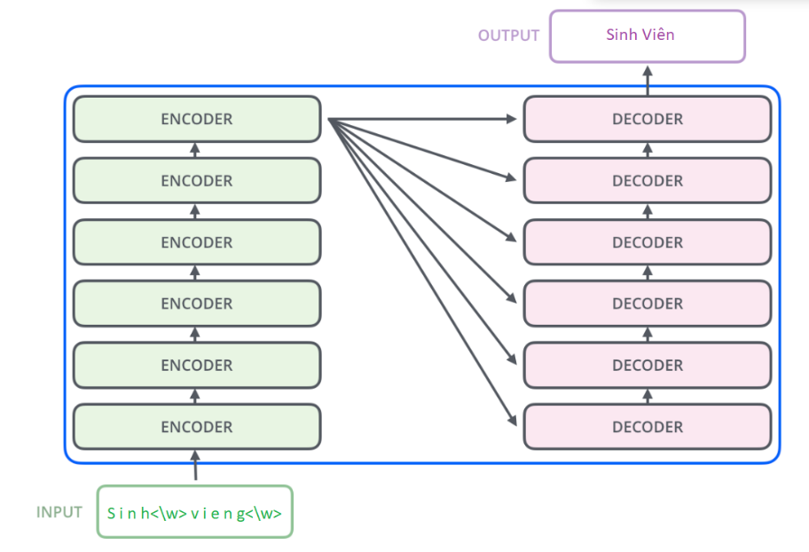
Modeling
Architecture of Transformer with Tokenization Repair
Transformer with 6 encoders and 6 decoders
Hidden size 768
Accept input as char-level tokens and sequentially generate word-level tokens
150M Parameters and Max Sequence Length of 512 (chars)

Slide 11

Modeling
Training Objectives
Using Teacher-Forcing Technique and minimize Cross Entropy Loss
$$CE= −\sum_{t=1}^{n}{log p_{θ}(y_{t}|y_{<t},x)}$$
With $t$ is time step, $p_{θ}(y_{t}|y_{<t},x)$ is the probability that the golden word $y_{t}$ is predicted knowing that previous golden words $y_{<t}$ is provided (teacher-forcing).

Slide 12
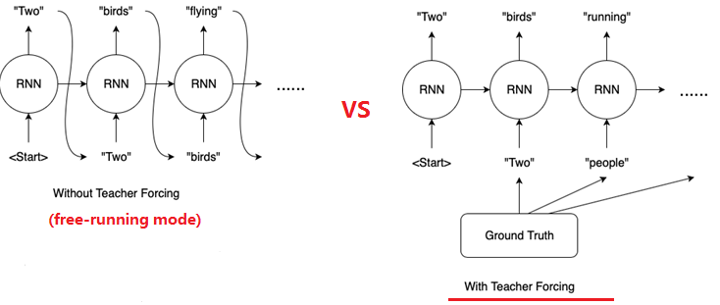
Teacher Forcing
Training Objectives

Slide 13
Datasets
We extract 12M sentences from binhvq/news-corpus to generate 20M sentence with misspelling errors
Misspelling errors is based on a confusion set and using simple rule-based error generator
We also generate some errors like
Remove Diacritics (nguyễn -> nguyen)
Replace with Typo (nguyễn -> nguyenx)
Random Editing (nguyễn -> ngyễm)
…

Slide 14
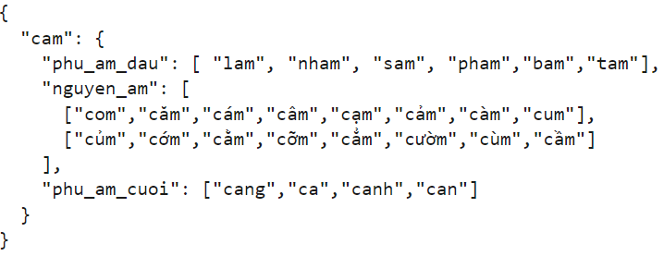
Datasets
Example of confusion set entries
-> The confusion set is used for real-word errors (word to another meaning words)

Slide 15
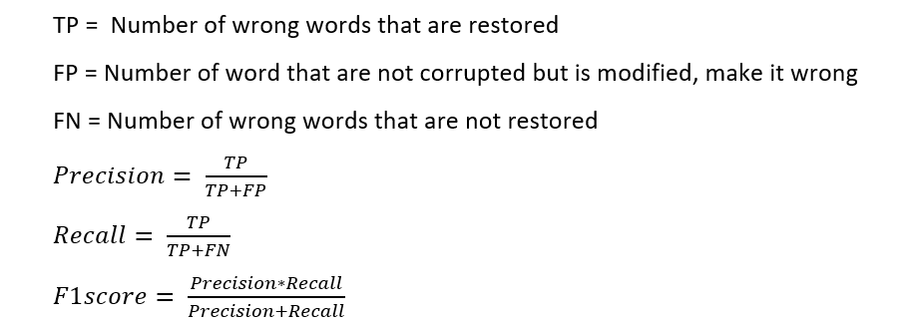
Training and Evaluation Details
Evaluation metrics
Use F1 score as main metric to evaluate model on both artificial dataset and VSEC public dataset.

Slide 16

Metrics Utils
Evaluation metrics
In order to know which words is modified or not, we use Needleman-Wunsch algorithm to align strings
Here is example when align two strings:

Slide 17
Training and Evaluation Details
Training Details
We finetune BARTpho model on our generated training dataset with the help of huggingface python library
Optimizer: AdamW with a weight decay of 0.01, base learning rate of 3e-5
Scheduler: Linear Schedule with WarmUp with warmup steps 5% first training examples.
Batch size: We use bucket sampling, set maximum of 1024 tokens per batch.
Epochs: Devide the dataset to 5 parts for lazy load and iterating over the whole.
Bucket sampling: Technique to group samples with similar length to reduce number of padding tokens needed to group samples into batch.

Slide 18
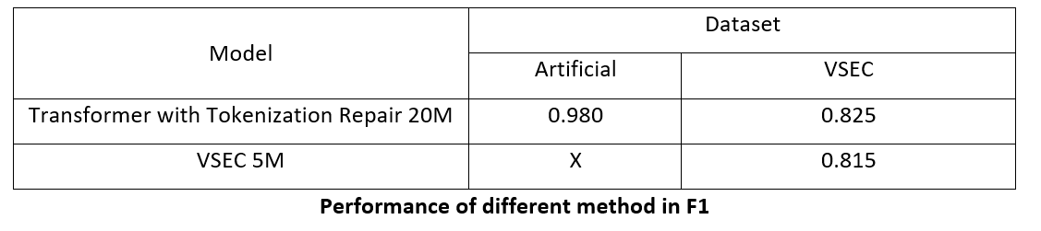
Experimental Results
Here is results of evaluation

Slide 19
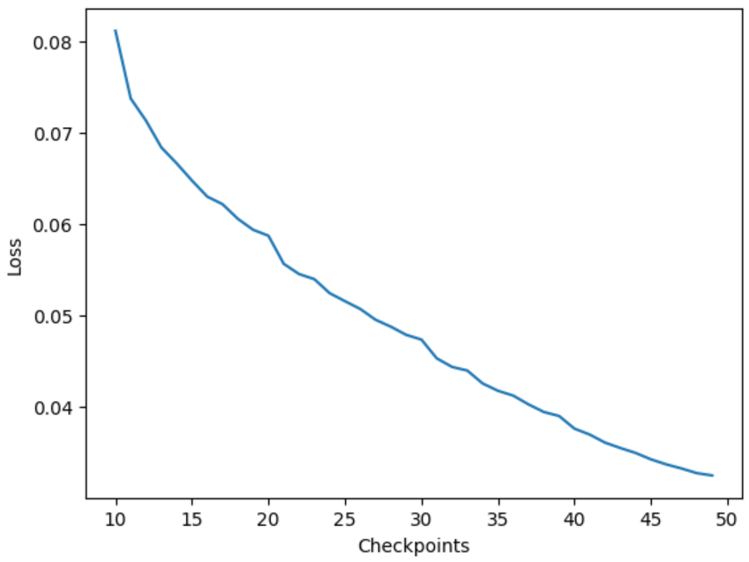
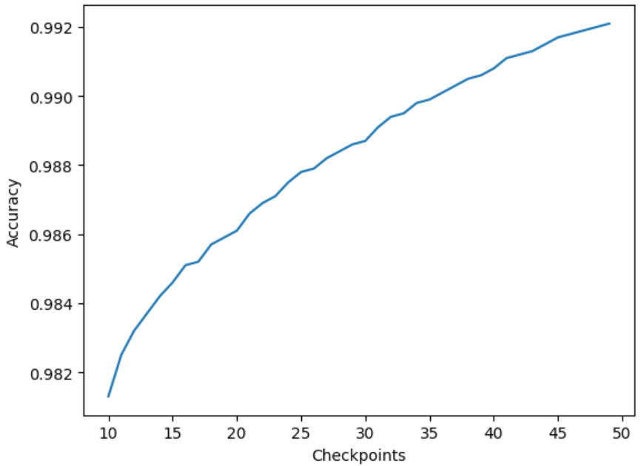
Experimental Results
We plot the validation set loss and accuracy each checkpoints

Slide 20
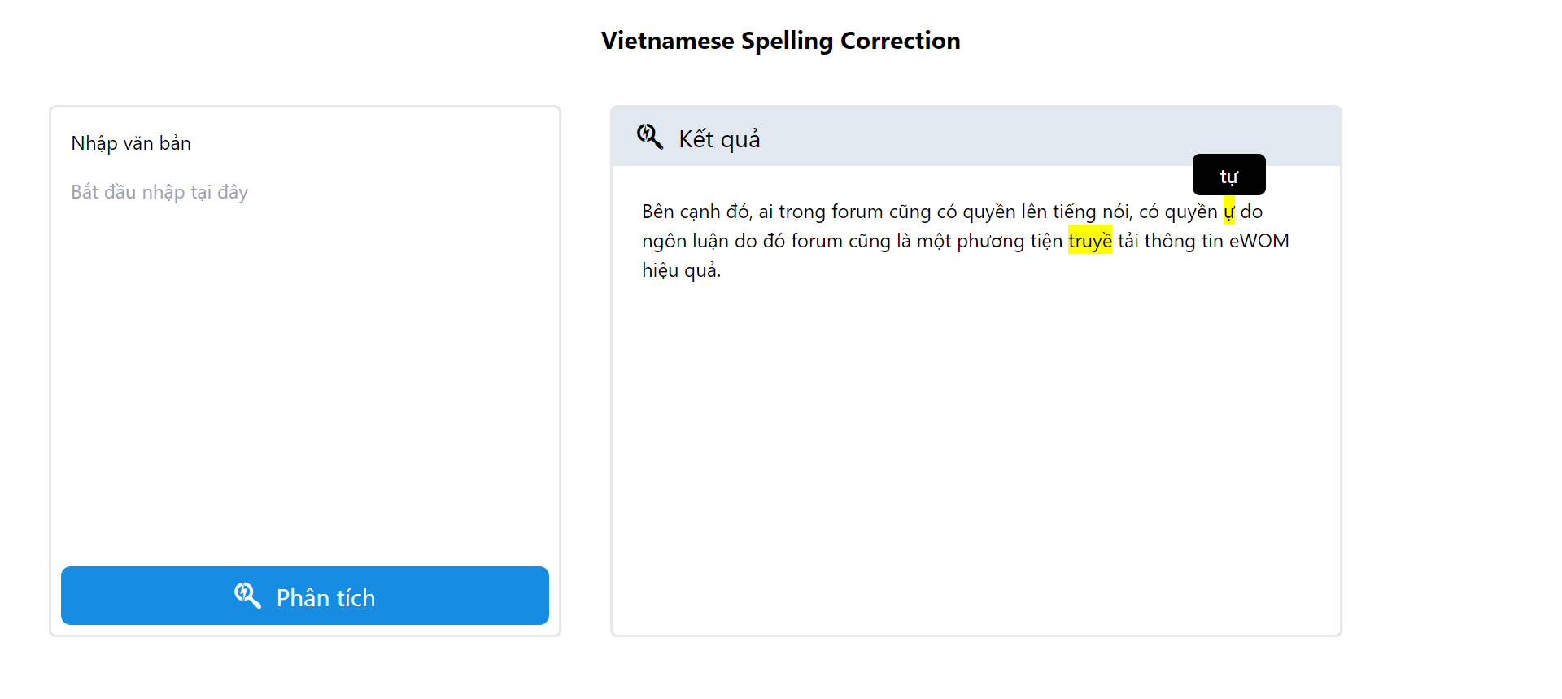
Demo Website

Slide 21


